Slide 1
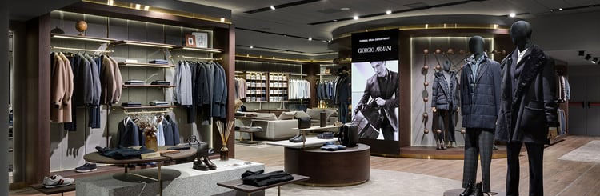


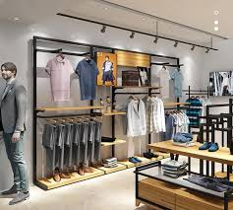
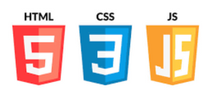
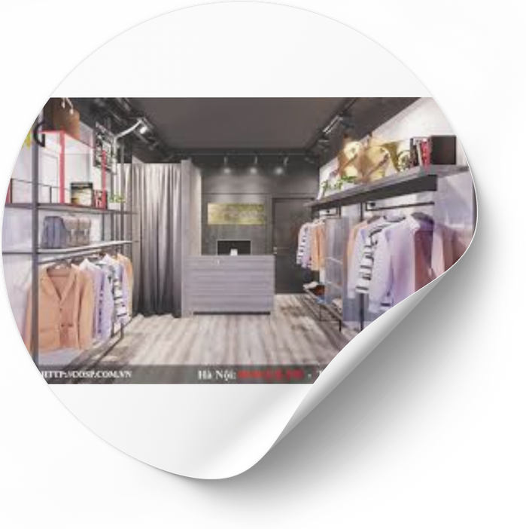





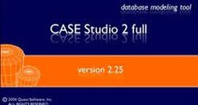
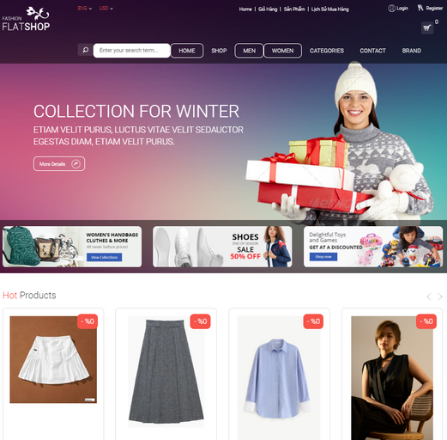
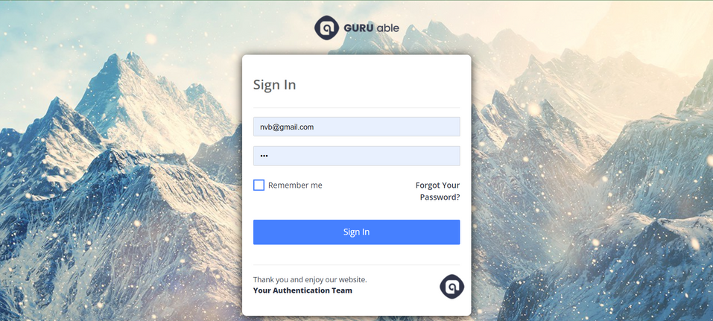
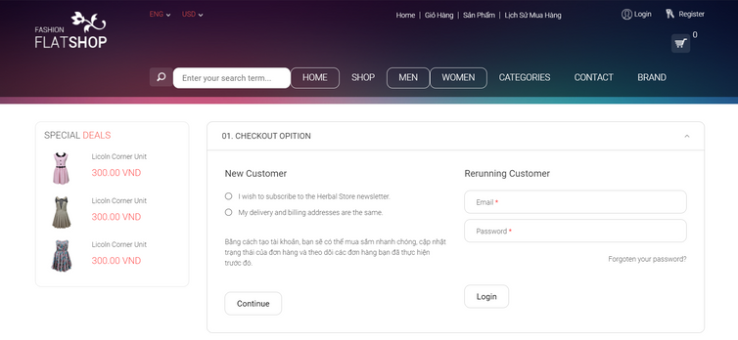
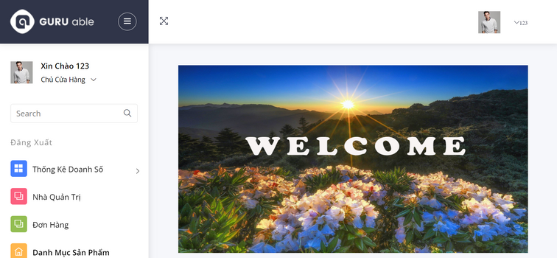
Build a website selling clothes using ASP.Net
INTRODUCTION
MATERIALS AND METHOD
Explore a comprehensive online clothing shopping web application with ASP.NET technology. Easily browse products, search and order, saving time. Guaranteed smooth, safe, and friendly. Enhance your brand today!
Frontend
Backend
RESULTS
CONCLUSION
Elevate your brand today! Having a modern, easy-to-use website helps your customers shop quickly and conveniently, while increasing revenue for your business. Order from our website for a great shopping experience for your customers!

